Slide 1



HOME CREDIT DEFAULT RISK ANALYSIS
MENTOR:Mr. Narendra Kumar

Slide 2
CONTENTS
Problem Statement
Workflow Diagram
Data Understanding and Preparation
Data Cleaning
Exploratory Data Analysis
Feature Engineering
Model Development and Training
Results
Conclusion

Slide 3
PROBLEM STATEMENT
In today's financial landscape, accurately assessing the risk of default on home credit loans remains a critical challenge for financial institutions. Existing credit evaluation systems often struggle to:
1
Effectively analyze diverse applicant data, including demographics, financial history, and loan attributes.
2
Identify key factors contributing to credit default, hindering proactive risk management.
3
Leverage predictive modeling techniques to forecast default probabilities with high accuracy.

Slide 4
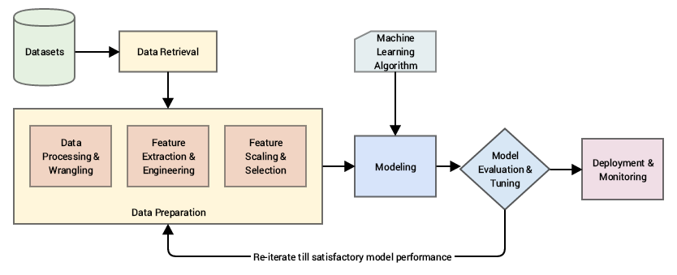
Workflow Diagram
Figure: Workflow Diagram of Home Credit Default Risk Analysis

Slide 5
DATA UNDERSTANDING AND PREPARATION
1
Source
7
Loan Details
4
Dropped columns
risk analysis dataset from github
with >50% missing values
loan_amnt, loan_int_rate, term_years, loan_intent, loan_grade.
imputed up to 13% missing values with mode/zero.
2
Objective
5
Conversions
8
Outcome
Predict loan default likelihood using demographic, financial, and transactional data.
negative values to positive
current_loan_status.
adjusted column datatypes.
3
6
9
Credit History
Data Inspection
Demographics
Analyzed dimensions, datatypes, and null values.
customer_age, customer_income, employment_duration.
historical_default, cred_hist_length, home_ownership.

Slide 6
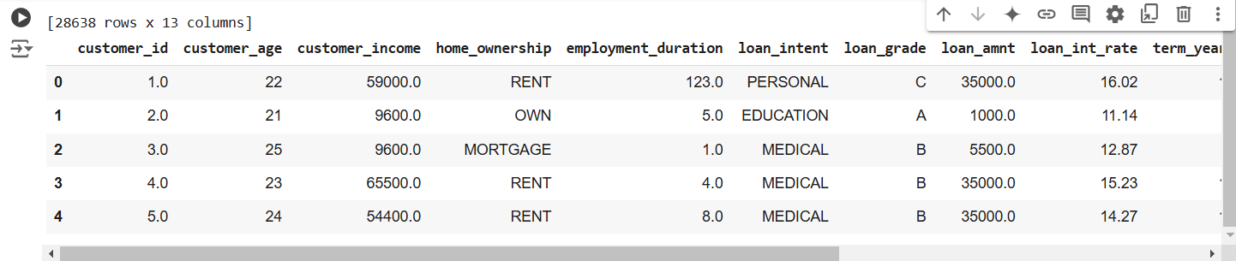
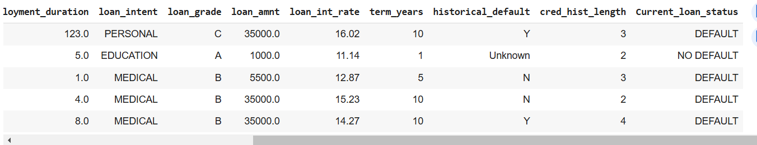
DATA CLEANING
Data Shape
Positive Transformation
28,369 rows and 13 columns capturing borrower details.
Converted negative values to positive; rounded them where necessary.
Data Type Conversion
Handling Missing Values
Numerical Columns:
Median imputation
avoids outlier impact.
Categorical Columns:
Replaced missing values
with the mode
Standardized all column
formats
Clean and complete dataset ready for analysis and modeling

Slide 7
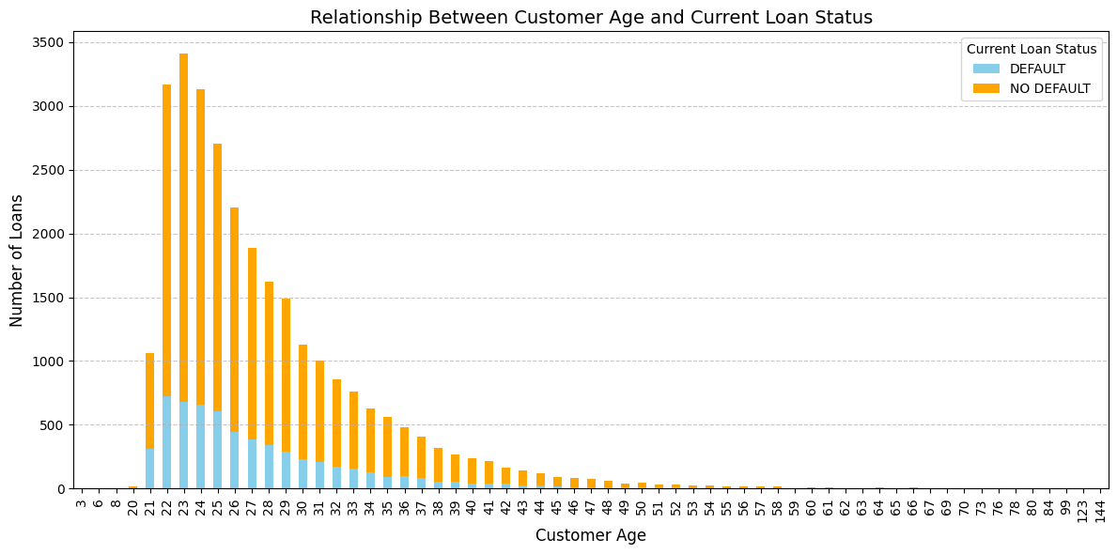
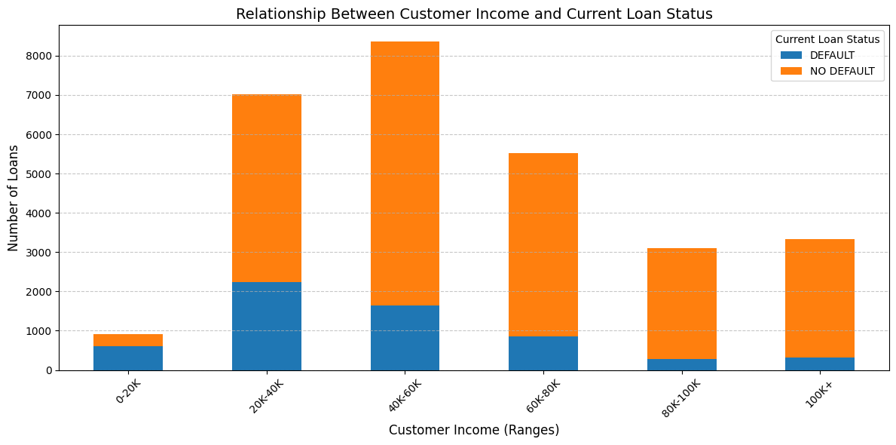
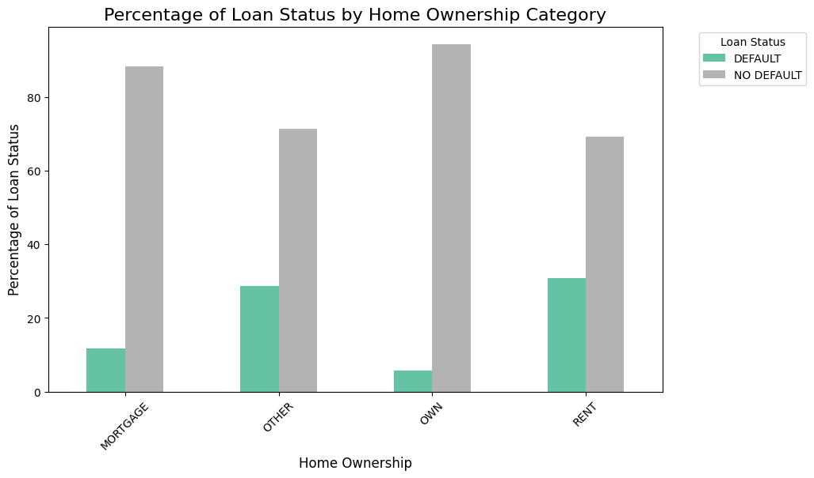
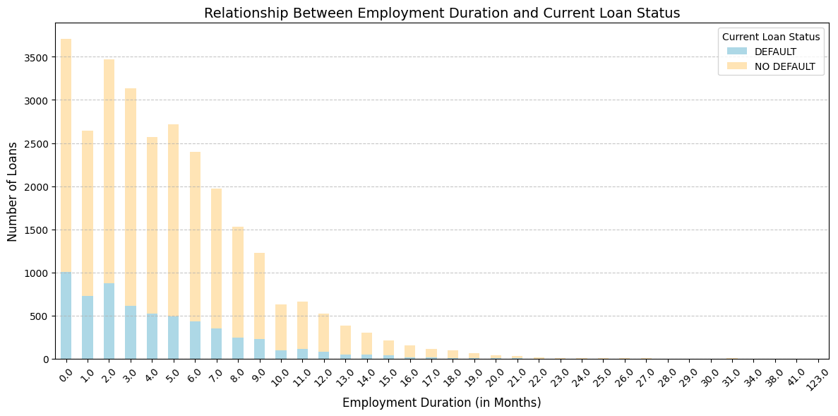
EXPLORATORY DATA ANALYSIS
The first graph shows that younger customers (primarily aged 20–30) have a higher number of loans, and the proportion of defaults decreases as customer age increases.
The first graph shows that Customers who rent tend to default more, while customers who own a house tend to default less.
The second graph shows default rate decreases as customer income increases, with higher-income groups showing a significantly lower likelihood of default.
The second graph shows a negative correlation between employment duration and loan default risk, with fewer defaults occurring as employment duration increases.

Slide 8
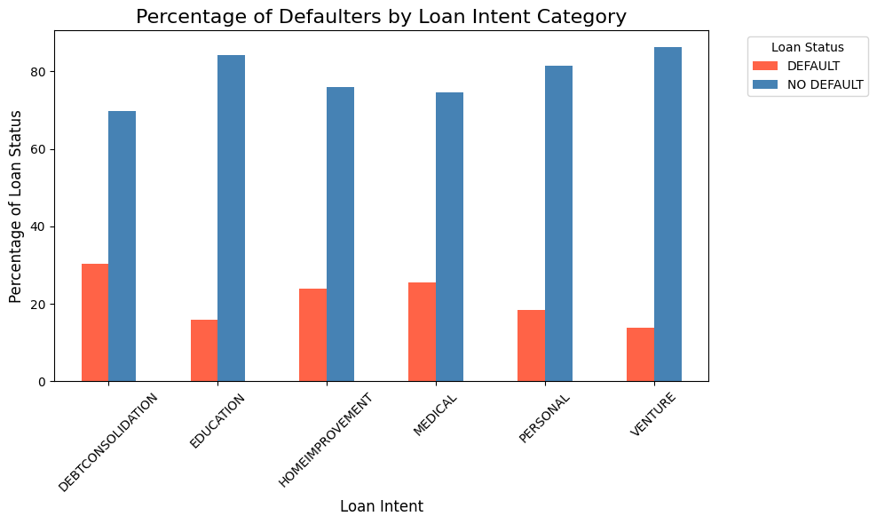
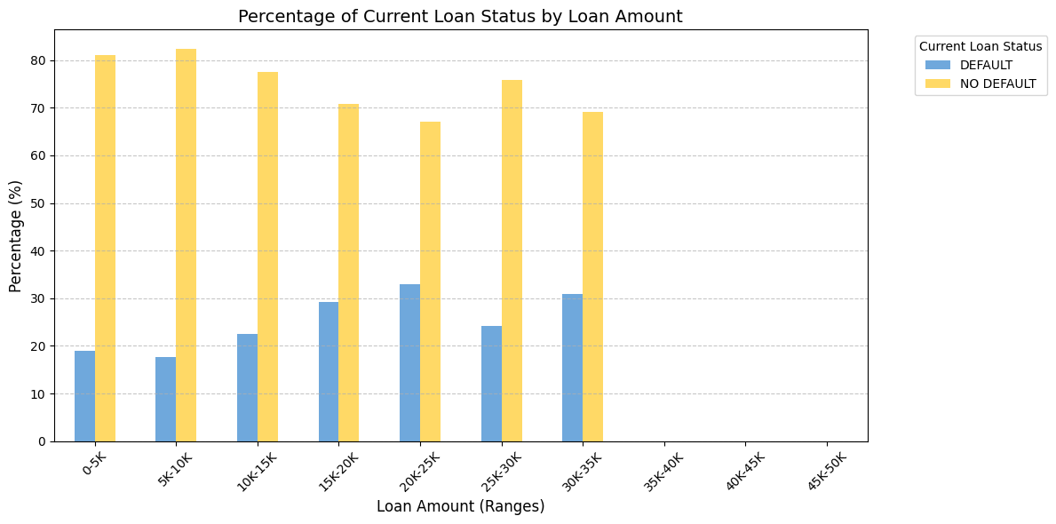
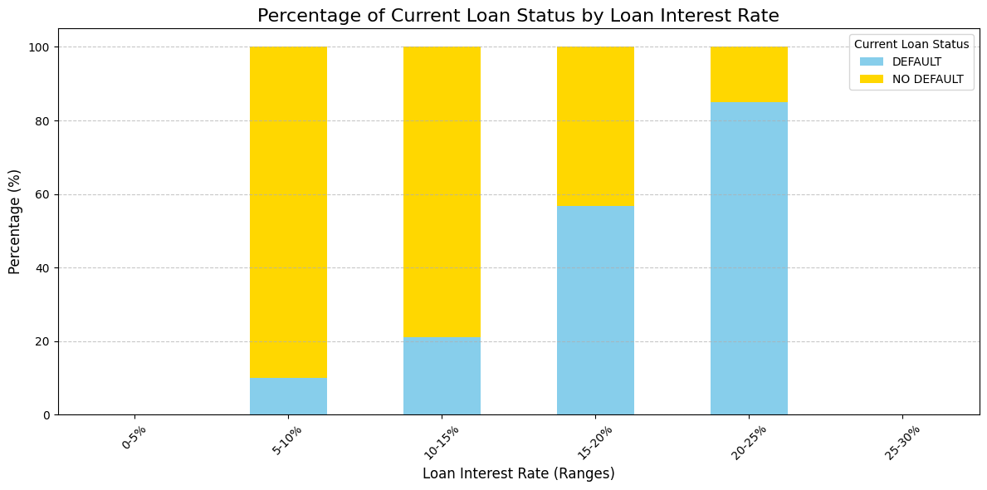
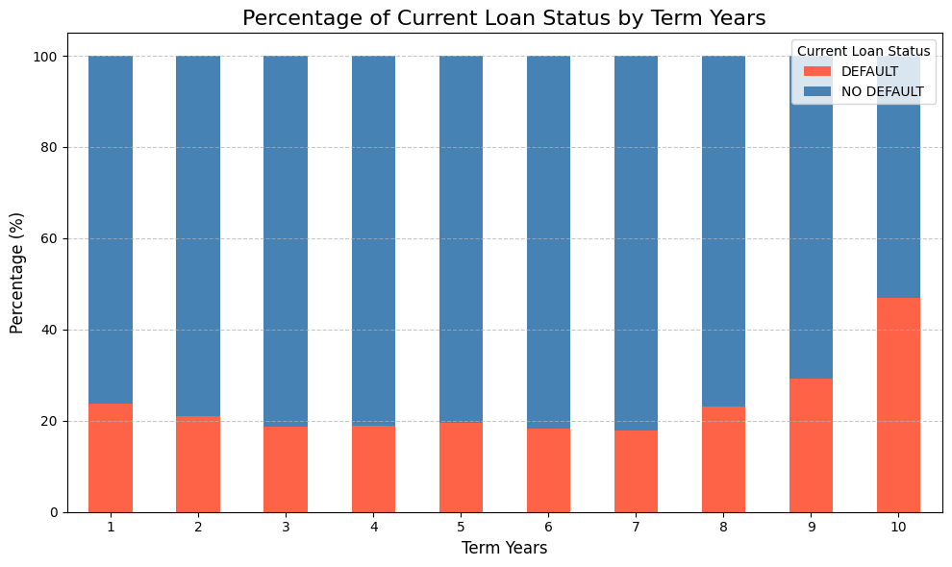
EXPLORATORY DATA ANALYSIS
Customers who take loans for the intent of ventures, followed by education, are the majority of loan payers, while customers who take loans for debt consolidation, followed by medical expenses, are the major defaulters.
Based on the first chart, loan default rates increase as the interest rate rises, with a significant proportion of defaults occurring in the 20-30% interest rate range, while lower interest rates (0-10%) show fewer defaults.
Customers with higher loan amounts (above $20K) tend to have a lower default percentage compared to those with smaller loans (below $20K), where defaults are relatively higher.
Based on the second chart ,Customers with shorter loan terms (1-5 years) show a lower default percentage, whereas longer terms (9-10 years) exhibit a noticeable increase in default rates

Slide 9
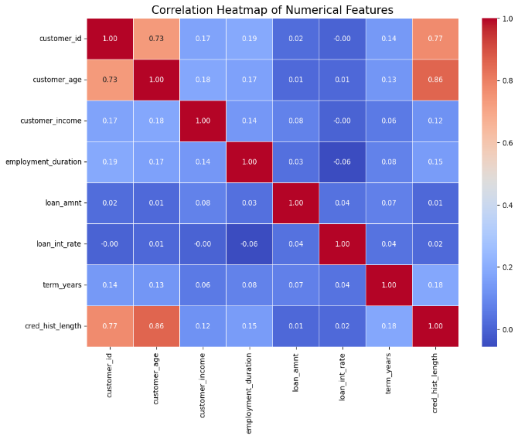
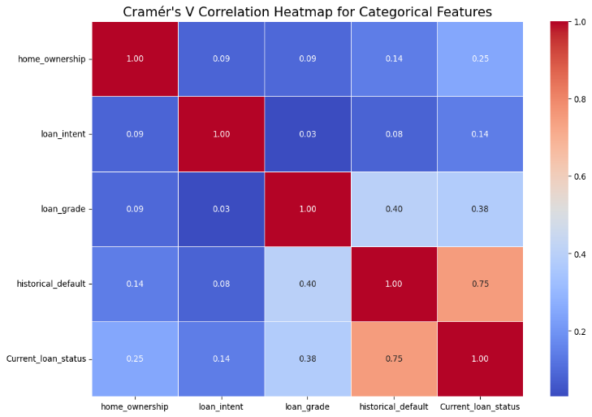
EXPLORATORY DATA ANALYSIS
Strong Correlations: Customer_age vs cred_hist_length
(0.86) and loan_amnt vs. customer_income (0.77)
Weak Correlations: Employment_duration shows minimal influence.
Strong Correlation: Historical_default and Current_loan_stat
us (0.75) strongly influence loan outcomes.
Moderate Correlations: Loan_grade links moderately with
Current_loan_status (0.38) and Historical_default (0.40).
Weak Correlations: Home_ownership and Loan_intent show
minimal influence.

Slide 10
FEATURE ENGINEERING
Target Variable Transformation
Converted Current_loan_status to binary (NO DEFAULT → 0, DEFAULT → 1).
Replaced historical_default values ('Unknown') with balanced 'Y' and 'N'.
Categorical Variable Encoding
Label Encoded features: home_ownership, loan_intent, loan_grade.
Credit Utilization Ratio
Calculated as loan amount ÷ customer income.
Not directly used in the model but essential for credit scoring

Slide 11
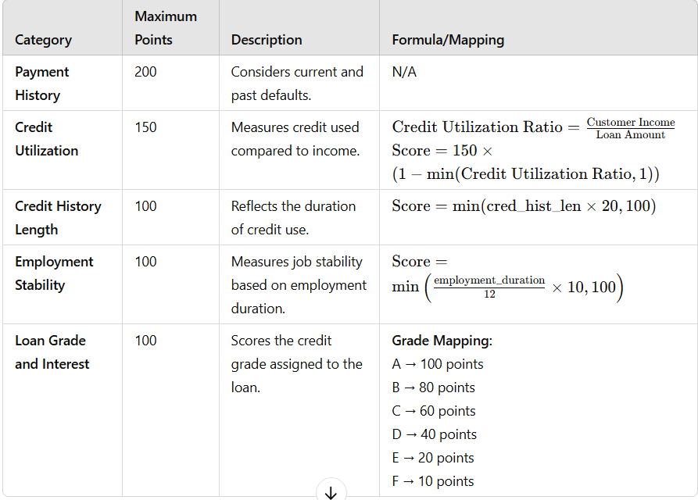
FEATURE ENGINEERING
Credit Scoring Process
Credit Scoring Formula
Credit Score=Base Score+(Payment History+Credit
Utilization+Credit History Length+Employment Stability
+Loan Grade Score)
Risk Categories
Excellent (800+): Very low risk
Very Good (740–799): Low risk
Good (670–739): Moderate risk
Fair (580–669): High risk
Poor (below 580): Very high risk

Slide 12
MODEL DEVELOPMENT AND TRAINING
Random Forest
Logistic Regression
Ensemble learning with 100 decision trees improved accuracy and robustness. Categorical features were encoded, and performance was evaluated using accuracy metrics and a classification report.
Developed a logistic regression model to predict loan default probability using optimized settings. Categorical features were encoded, and performance was assessed through accuracy and a classification report.
Neural Networks
XGBoost
Developed a neural network with two hidden layers to detect patterns in loan default data. Data was normalized, encoded, and split for training/testing, with the model trained using the Adam optimizer.
Implemented XGBoost with SMOTE to address class imbalance and enhance performance. Preprocessed data, split into training/testing sets, and evaluated using a classification report and accuracy score.

Slide 13
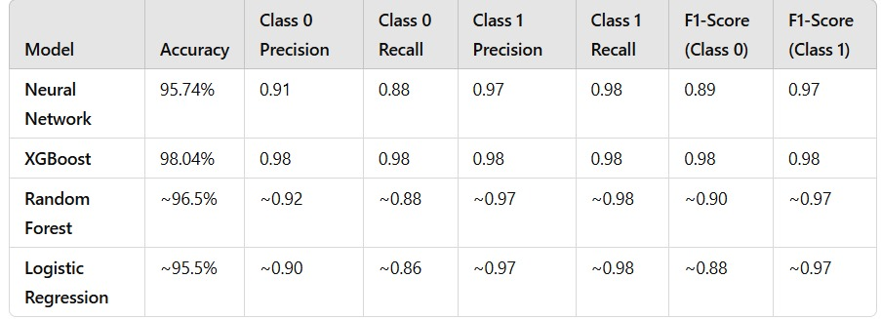
MODEL DEVELOPMENT AND TRAINING
Comparison and Analysis:
Accuracy: Correct predictions as a percentage of total predictions.
Precision: True positives among all predicted positives (model correctness).
Recall: True positives among all actual positives (model sensitivity).
F1-Score: Harmonic mean of Precision and Recall (balance metric).
XGBoost performs the best overall

Slide 14
RESULTS

Slide 15
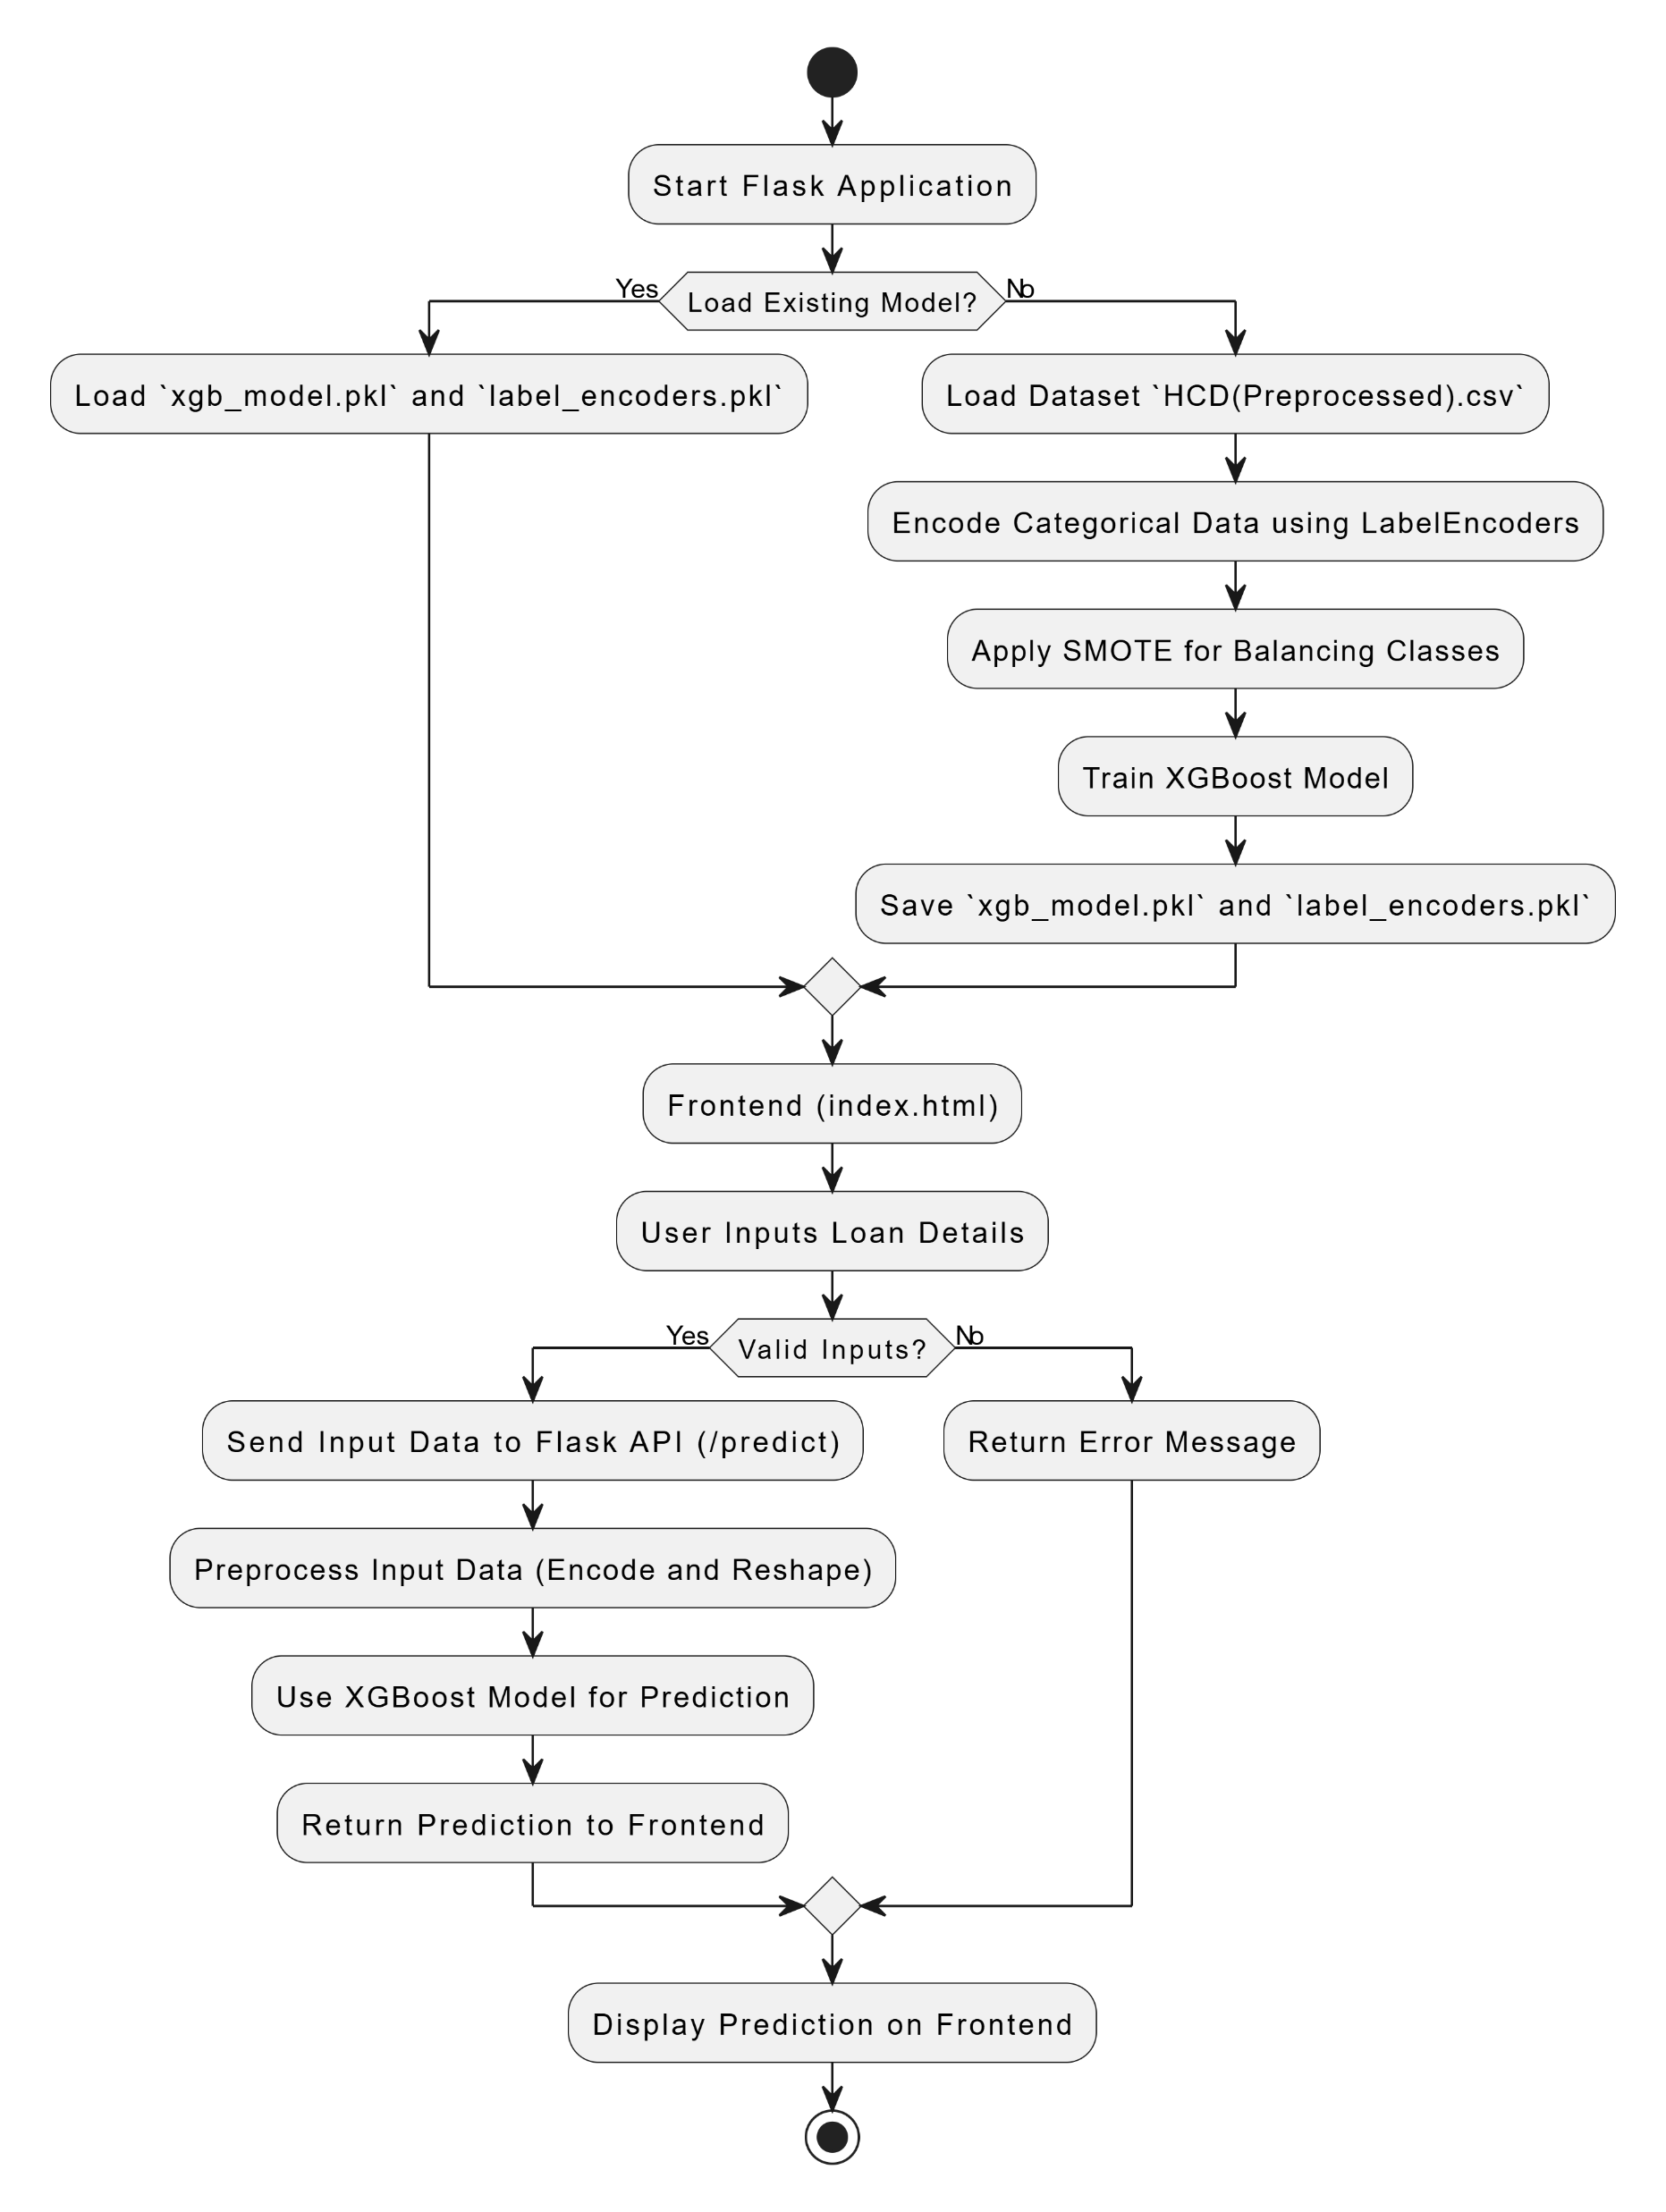
CONCLUSION
Effective Models: XGBoost excelled in predicting loan defaults.
Feature Engineering: Improved model performance by 15% with impactful features like credit utilization.
Key Insights: Demonstrated the value of strong algorith-
ms and well-designed features for accuracy.
Credit Evaluation: Advanced methods enhance credit ri-
sk assessment and efficiency.
Figure :Proposed workflow for application Development

Slide 16

THANK YOU

